Slide 2
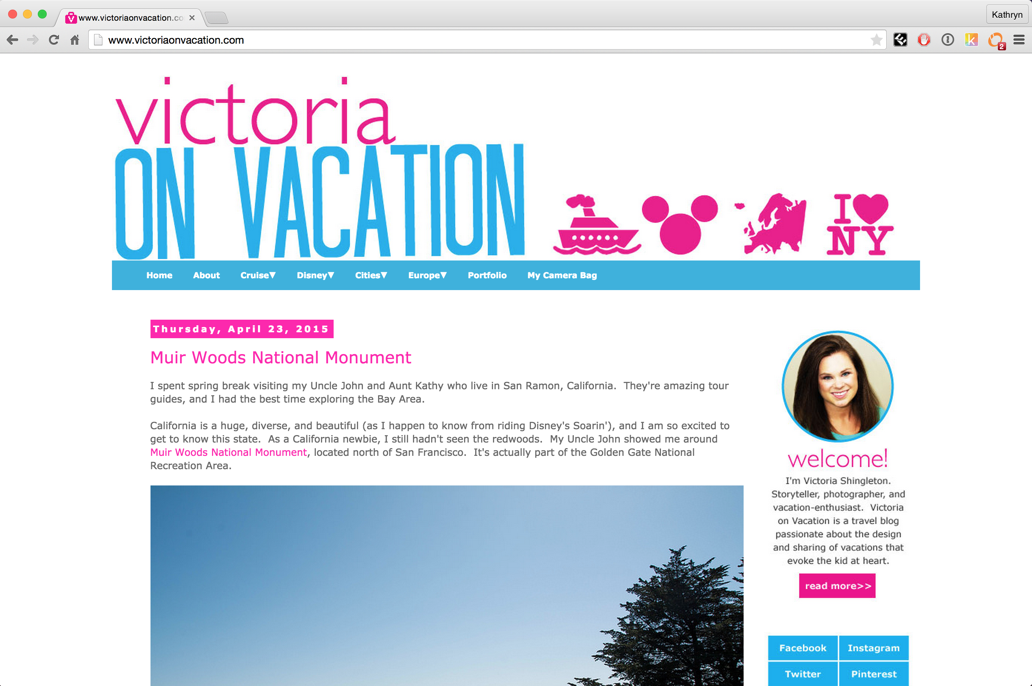
< 1000 visitors per month

Slide 3

170 million visitors per month

Slide 4
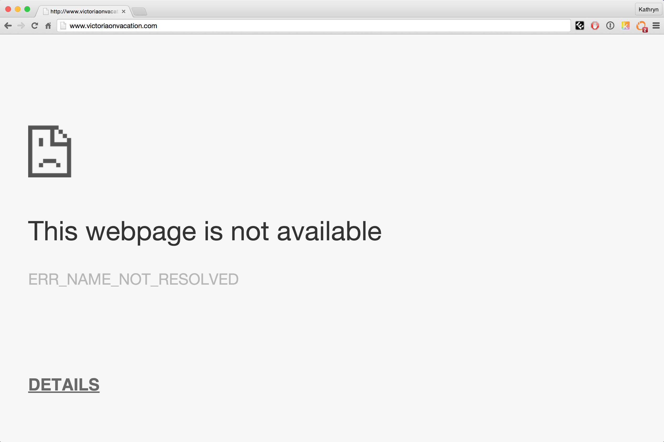
reddit hug of death
Millions of hits
Notes:
Server cannot respond to so many requests.

Slide 5
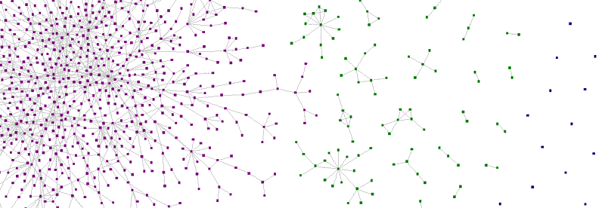
Zauberflöte: A Peer-to-Peer CDN
Katie Siegel
Teammates: Anish Athalye & Ankush Gupta

Slide 6
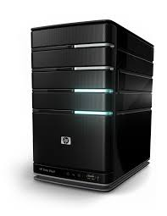

CDN: Content Distribution Network

Slide 7
Four Steps
Determine who has the resource
Open connection with peers
Request resource from peers
Advertise resource

Slide 8
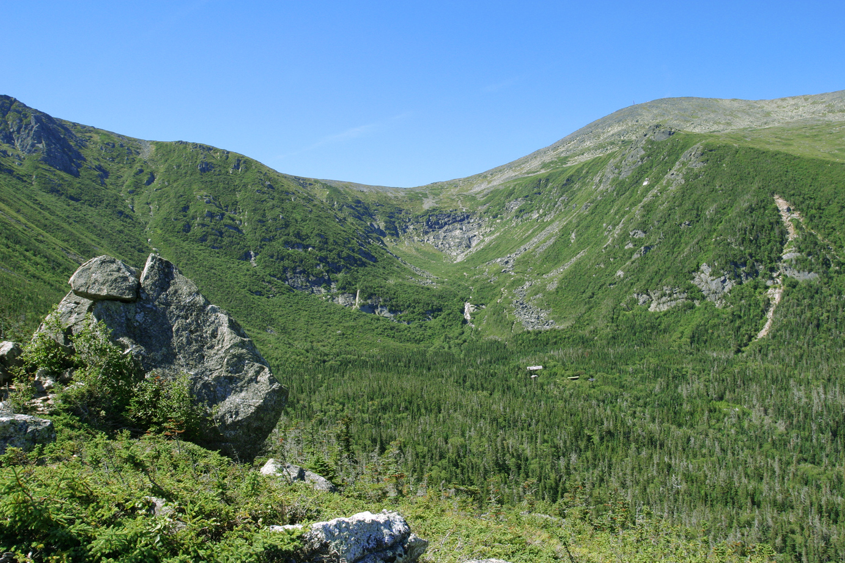
1. Determine who has the resource
hash

Slide 9
1. Determine who has the resource
{Hash}
Tracker
{Hash, Peers}

Slide 10

2. Open connection with peers

Slide 11
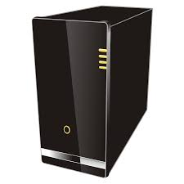
2. Open connection with peers
get
STUN
server
ice candidate,
offer
ice candidate,
offer
answer
answer
ice candidate
Notes:
Interactive connectivity establishment

Slide 12
3. Request resource from peers
Data
{hash, chunk_num, payload}
Request
{hash, chunk_num}
Data
{hash, chunk_num, payload}
Request {hash, chunk_num}

Slide 13
4. Advertise Resource
Advertise
{hash}

Slide 14
Implementation
Download Manager
Tracker & Signaling Channel
Browser injection
code
Connection Manager

Slide 15
Demo Time

Slide 16
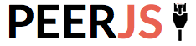


Alternatives
Notes:
Not open source, paid, not transparent

Slide 17
Benefits
Lighten server load
Increase bandwidth
Free
Lightweight
Transparent & Open Source

Slide 18
Questions?

